Slide 1

LEAD SCORING ANALYSIS FOR ONLINE COURSES USING SCI-KIT LEARN
ABHINAV TRIPATHI (RA1911003030147)
SHUBH MEHROTRA (RA1911003030141)
PRAKHAR KUMAR (RA1911003030136)
AKARSH SINGH (RA1911003030165)
Guide Name: Dr.Ruby Singh
MAY 2023

Slide 2
ABSTRACT
The project aims to develop a lead-scoring system using logistic regression to predict the probability of a potential customer becoming a lead for a business. The system involves data collection, preprocessing, feature extraction, model training, model evaluation, deployment, and integration with other systems. The project seeks to improve the accuracy and efficiency of lead scoring by leveraging machine learning techniques. The system aims to be scalable and easily integrated into existing business workflows. The performance of the system will be evaluated through various testing techniques to ensure its accuracy and reliability in predicting lead scores. The system can also work with large and complex datasets.

Slide 3
INTRODUCTION
The lead score prediction project aims to provide businesses with a tool to predict the likelihood of a potential customer becoming a paying customer. By analysing various factors such as demographics, online behaviour, and previous interactions with the business, the lead score prediction model can identify the potential customers who are most likely to convert to paying customers.
The project uses logistic regression as the primary machine learning algorithm for lead score prediction. logistic regression is a simple and interpretable algorithm that is well-suited for regression tasks, making it a suitable choice for lead score prediction. This proposal consists of several steps, such as data collection, feature extraction, preprocessing, model training, model evaluation, and deployment and integration.
The project aims to address the limitations of the existing system for lead score prediction using SVM. The SVM algorithm can be complex, sensitive to outliers, difficult to interpret, and struggle with non-linear relationships and large or imbalanced datasets. By using logistic regression as the primary machine learning algorithm, the proposed system can provide a simpler and more interpretable alternative to the existing system.
The lead score prediction project has several potential benefits for businesses, including increased efficiency and effectiveness in identifying potential customers who are more likely to convert to paying customers. By identifying these potential customers, businesses can target them with personalized marketing campaigns and increase their chances of conversion.

Slide 4
EXISTING SYSTEM
The SVM algorithm is one example of an existing lead scoring system.
SVM is a complex algorithm that can be computationally expensive and require expertise to tune.
SVM is sensitive to outliers and can struggle with noisy or imbalanced datasets.
SVM can be difficult to interpret and understand which features are important for prediction.
SVM assumes linear relationships between input features and the target variable, making it challenging to handle non-linear relationships.
SVM can struggle with large or imbalanced datasets, resulting in bias towards the majority class.
SVM is known as a Support Vector Machine.
SVM can not scale to large datasets.

Slide 5
PROPOSED SYSTEM
For classification tasks like lead scoring, a popular machine learning approach is logistic regression.
An algorithm would be trained on historical lead data, including information on demographics, behavior, and interactions with marketing materials, in a system for lead scoring that uses logistic regression.
The computer would then make use of this training data to create a predictive model that gives fresh incoming leads a lead score based on their traits.
The potential sensitivity of Logistic Regression to outliers in the data is one drawback of utilizing it for lead scoring.
As a result, the model's predictions may be significantly impacted by extreme values in the data, which could result in erroneous lead scores.
To prevent this problem, it is crucial to thoroughly preprocess the data and eliminate any outliers before training the model.

Slide 6
LITERATURE SURVEY
S.N O | TOPIC | INFERENCE | ADVANTAGES | DISADVANTAGE S | ALGORITHM
1 | Evaluation of CET-4 and CET-6 Courses on Online Learning Platform Author : Zhao, Y., Li, L., Li, X., & Li, B. | The study solves the issue by evaluating Tencent classroom courses by course organization, pricing, registration population, and other indices using data mining, statistical analysis, word cloud analysis, and other approaches | The paper also selects courses depending on learners' willingness to pay. | The accuracy was not as expected, could have been more precise. | Data mining, statistical analysis
2 | Research on the Construction of Network Course Platform Based on Big Data Author : Li, Q., Wang, X., Wang, J., Liu, H., & Ma, Q. | Curriculum development is key to improving higher education. | An intuitive model development interface simplifies data mining model management. | The model lacked the higher order functionalities. | Big Data

Slide 7
3 | Development of an Online Course for Web Programming. Author :Kim, H. J., Kim, J. E., & Kim, K. J | Theoretical and practical features allow the author to build a course, specify a time period, indicate a measure, and assess student performance after course completion. | Shows OLAT online course implementation. These technologies tailor learning to student comprehension. | Speed in terms of processing was low. | Web programming- using OLAT.
4 | A designed platform for programming courses Author : Lin, C., & Chen, Y. | The portal validates codes and manages courses, students, and issues. Code format and comments help pupils learn to code. Teachers can assess class learning with software broadcast and statistical data. | The platform improved teaching after a semester of testing. | The model was designed for limited or specific courses alone | MOOCs

Slide 8
5 | Online Teaching Practice in Chinese Culture Course Author : Liu, J. | This study focuses on online teaching and Chinese cultural course student responses. | Online education is easy and practical. | The accuracy was not as expected, could have been more precise. | Experimental Analysis
6 | Research on the Construction of the Quality Evaluation Indicator System of "Online Golden Course Author : Wang, M., Zhao, J., & Li, Y. | The "Online Gold Course'' demands rigorous and impartial quality assessment. Using Total Quality Management theory and influencing factors, this research creates a curriculum quality evaluation indicator system from the four dimensions of teaching, student performance, curriculum, and learning platform. | Principal Component Analysis improves student-centered "Online Golden Course" quantitative evaluation | More complex | Virtual Equipment Digital Media Technology

Slide 9
7 | Online Immersive Platform Image Processing Algorithm for Art Courses based on Virtual Equipment Digital Media Technology Author: J. Wang, W. Guo | This article describes virtual reality technology and digital media art, analyzes their production, and establishes their meaning, connection, benefits, and qualities. Hemisphere display requires pre-distortion. | An embedded processing platform image processing confidence interval and mathematical expectation technique reduces low-light video noise. | The model lacked the higher order functionalities. | Image Semantic Segmentation
8 | Application of Audio Processing Based on Image Semantic Segmentation in Applied Mathematics Online Course Author: T. Kiyokawa, H. Katayama | It analyzes applied mathematics network courses, explores the connotation, characteristics, strategies, and information resources of engineering mathematics network courses, and builds the online course teaching platform for students to understand mathematics education and teaching | It boosts after-class review to 6.5% and promotes lifelong learning. | The model was designed for mathematical-ce ntric courses. | MOOCs

Slide 10
9 | Research on Evaluation System of User Experience With Online Live Course Platform Author: R. Jin, H. Huang | Study proposes a comprehensive user experience evaluation system to identify platform flaws and suggest improvements for online courses. | Two software samples have significant differences in multiple second-level indices but their overall scores are similar, consistent | Speed in terms of processing was low. | Modeling-eliciting activities
10 | Modeling-Elicitin g Activities in an Online Engineering Course for Improving Conceptual Learning Author: M. R. Kounte, N. N, P. S. Hegde | The suggested technique helps students make smart judgments and take action, improving critical thinking. | The MEA also promotes online course involvement, according to online teaching platform data. | The accuracy was low | Data mining, statistical analysis

Slide 11
MODULE IMPLEMENTATION
The modules included are
Data Collection and Preprocessing
Feature Extraction
Model Training
Model Evaluation
Deployment and Integration

Slide 12
DATA COLLECTION AND PREPROCESSING
Data collection and preprocessing are essential steps in lead score prediction using logistic regression. The collected data must be accurate, complete, and relevant to the lead score prediction model. Preprocessing may involve cleaning, transformation, normalization, and feature selection. Developers should also consider data bias, scalability, and maintainability in the data collection and preprocessing pipeline. Exploratory data analysis and hypothesis testing can help evaluate the quality of the data. By carefully collecting and preprocessing data, developers can ensure that the lead score prediction model is accurate and reliable. Data collection may involve collecting data from various sources, such as CRM systems, marketing automation platforms, and social media platforms. The collected data may include information such as customer demographics, customer behavior, and customer interactions with the business.
Overall, data collection and preprocessing are critical steps in lead score prediction using logistic regression. By carefully collecting and preprocessing data, developers can ensure that the lead score prediction model is accurate, reliable, and effective.

Slide 13
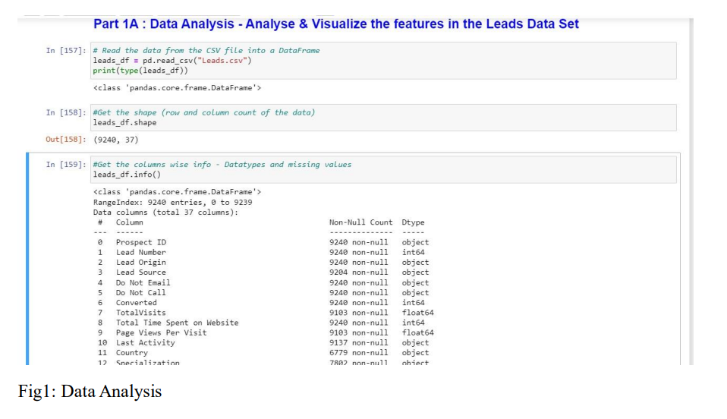

Slide 14
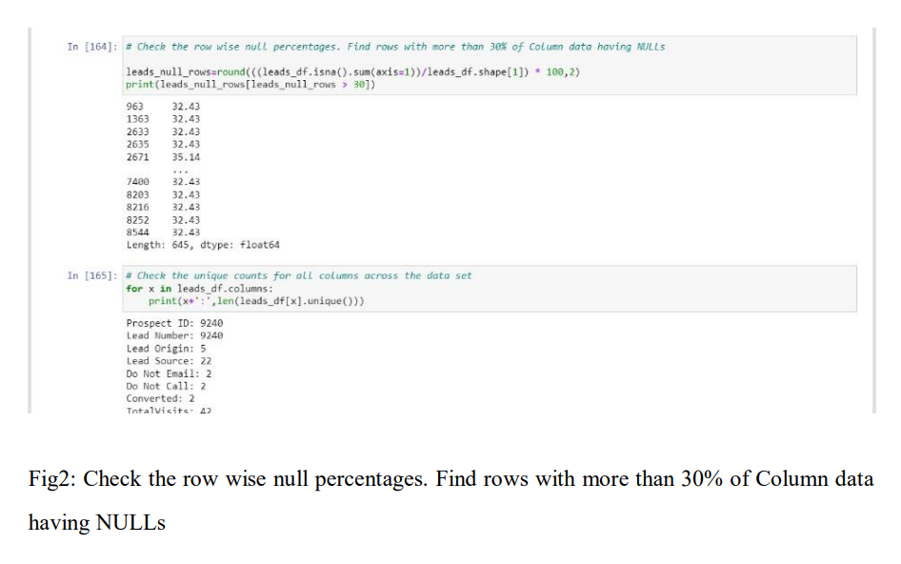

Slide 15
FEATURE EXTRACTION
Feature extraction is an important step in lead score prediction using logistic regression. This involves identifying the most relevant features from the preprocessed data that can be used to predict the lead score. Techniques such as correlation analysis, principal component analysis, recursive feature elimination, and lasso regression can be used to identify important features. Domain expertise and business knowledge can also be helpful in identifying relevant features. However, it is important to strike a balance between feature extraction techniques and business knowledge to ensure that the selected features are both relevant and interpretable. The selected features can then be used to train the logistic regression model for lead score prediction. It is important to consider the potential impact of feature extraction on the accuracy and interpretability of the model. Overall, feature extraction helps improve the accuracy and efficiency of the lead score prediction model while ensuring that the selected features are relevant and interpretable.

Slide 16
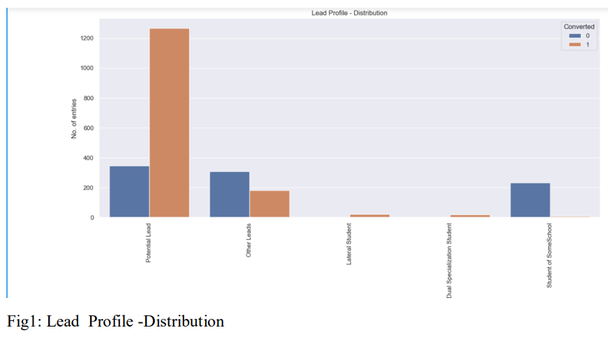

Slide 17
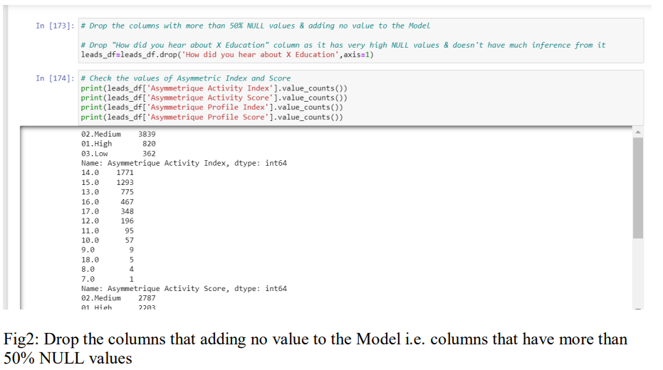

Slide 18
MODEL TRAINING
Model training in lead score prediction using logistic regression involves finding the best set of coefficients for the logistic regression equation to accurately predict the lead score. Techniques such as Ordinary Least Squares, Gradient Descent, Regularization, and Cross-Validation can be used for model training. Evaluating the performance of the trained model is important to ensure its accuracy and reliability. The model's assumptions and limitations should also be evaluated and addressed using techniques such as residual analysis. Scalability and efficiency are also important considerations in model training, and techniques such as distributed computing or parallel processing may be necessary for large datasets. By carefully selecting appropriate model training techniques, evaluating the model's assumptions and limitations, and ensuring scalability and efficiency, developers can create an accurate, reliable, and effective lead score prediction model.

Slide 19
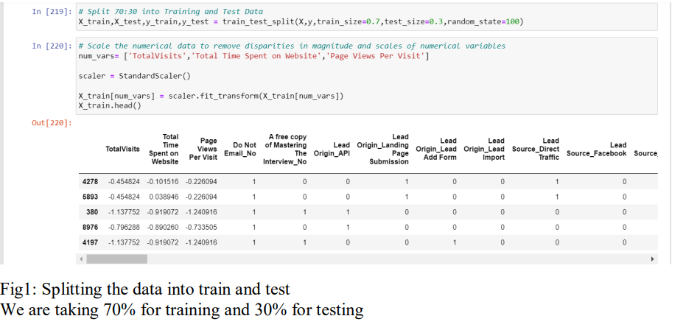

Slide 20
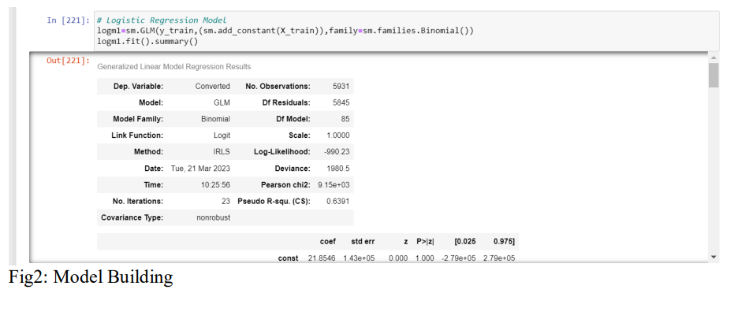

Slide 21
MODEL EVALUATION
Model evaluation in lead score prediction using logistic regression is crucial to ensure the model's accuracy, reliability, and generalization ability. Techniques such as mean-squared error, R-squared, residual analysis, and cross-validation can be used for model evaluation. The results of the model evaluation should be interpreted in the context of the business problem being addressed, considering the potential impact of false positives and false negatives. Hyperparameter optimization and comparison with other machine learning models can help identify the best approach for lead score prediction. It is also important to consider potential limitations and uncertainties associated with the model, such as data quality and changes in the business environment. Regular monitoring and updating of the model can ensure that it remains accurate and relevant.

Slide 22
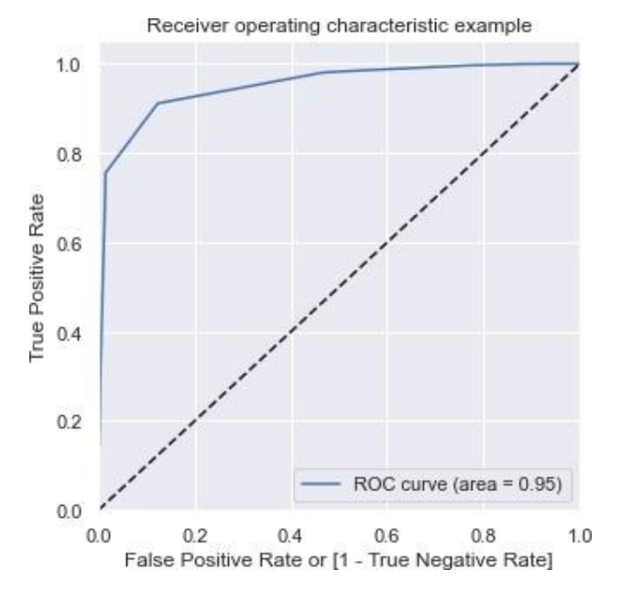

Slide 23
DEPLOYMENT AND INTEGRATION
Deployment and integration are important steps in lead score prediction using logistic regression. Deployment involves deploying the trained model into a production environment, while integration involves integrating the model with other systems. Techniques such as API deployment, containerization, model versioning, and integration with other systems can be used for deployment and integration. It is also important to consider factors such as scalability, monitoring, data security, and continuous integration during deployment and integration. These factors can help ensure that the model is effective and useful in a production environment. Additionally, the deployed model should be scalable, monitored and maintained regularly, and ensure the security and privacy of the collected data. Continuous integration and deployment should be used to automate the deployment process to reduce downtime and improve efficiency.

Slide 24
CODE
# Lead Source_direct traffic
lead_source_direct = st.number_input("Lead Source_direct traffic", value=0)
# Lead Source_welingak website
lead_source_welingak = st.number_input("Lead Source_welingak website", value=0)
# Do Not Email_yes
do_not_email = st.number_input("Do Not Email_yes", value=0)
# Last Activity_had a phone conversation
last_activity_phone = st.number_input("Last Activity_had a phone conversation", value=0)
# Last Activity_olark chat conversation
last_activity_chat = st.number_input("Last Activity_olark chat conv
import streamlit as st
import joblib
import pandas as pd
import numpy as np
from sklearn.preprocessing import StandardScaler
st.title("Lead scoring dataset")
model = joblib.load("leads.C5")
# Total Time Spent on Website
total_time_spent = st.number_input("Total Time Spent on Website", value=0)
# Lead Origin_lead add form
lead_origin = st.number_input("Lead Origin_lead add form", value=0)
ersation", value=0)

Slide 25
CODE
features = features.reshape(1,-1)
scale = StandardScaler()
scale.fit(features)
pred = model.predict(features)
if st.button("Predict"):
if pred[0]==1:
st.write("Lead found")
else:
st.write("lead not found")
# Last Activity_sms sent
last_activity_sms = st.number_input("Last Activity_sms sent", value=0)
# What is your current occupation_working professional
occupation_working = st.number_input("What is your current occupation_working professional", value=0)
# Last Notable Activity_unreachable
last_notable_activity = st.number_input("Last Notable Activity_unreachable", value=0)
features = np.array([total_time_spent,lead_origin,lead_source_direct,lead_source_welingak,do_not_email,last_activity_phone,last_activity_chat,last_activity_sms,occupation_working,last_notable_activity])

Slide 26
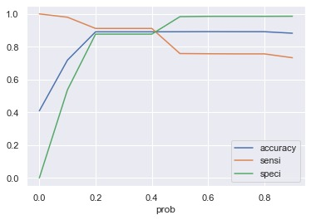
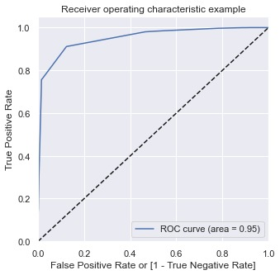
OUTPUT

Slide 27
CONCLUSION
The proposed system for lead score prediction using logistic regression is a simpler and more interpretable alternative to existing systems. It involves data collection, preprocessing, feature extraction, model training, evaluation, and deployment. Logistic regression is advantageous due to its simplicity, interpretability, scalability, and flexibility, and has the potential to help businesses identify potential customers. However, developers should consider the limitations and assumptions of logistic regression, which can lead to poor model performance and overfitting. By addressing these limitations and using appropriate techniques, the proposed system can provide accurate and interpretable predictions of lead scores. Integration and performance testing can also help ensure the system is responsive, reliable, and scalable. Overall, the proposed system using logistic regression can be a valuable tool for businesses in predicting and identifying potential customers.

Slide 28
RESULTS
The proposed system for lead score prediction using logistic regression can provide accurate predictions for businesses if the data quality, feature selection, and model hyperparameters are appropriate. Performance metrics like MSE, R-squared, or RMSE can be used to evaluate the model, and visualizations such as scatter plots or heatmaps can provide insights into the data. By using proper data collection, preprocessing, feature extraction, and model training techniques, developers can ensure that the logistic regression model accurately predicts lead scores and is integrated with other systems. logistic regression's simplicity, interpretability, scalability, and flexibility make it suitable for lead score prediction tasks that involve large amounts of data and different data types. However, developers must consider the limitations and assumptions of logistic regression when designing the system, and appropriate techniques should be used to address them to ensure accurate and interpretable predictions of lead scores.

Slide 29
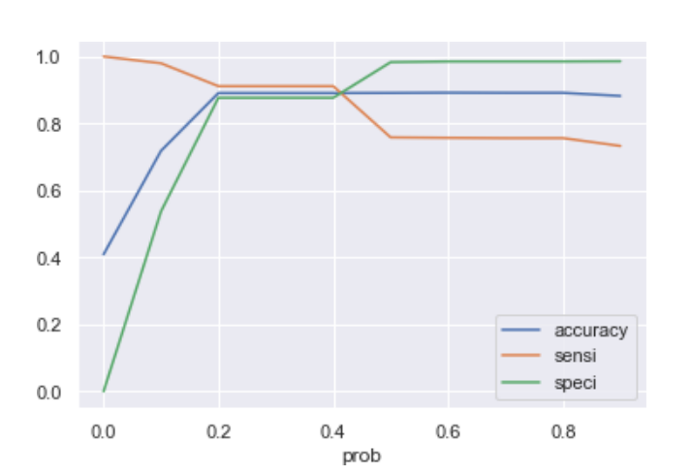

Slide 30
FUTURE SCOPE
Future scopes for the proposed system using logistic regression for lead score prediction include advanced feature selection techniques, more advanced machine learning algorithms, incorporating more data sources, and integrating with other systems. Genetic algorithms and neural networks can improve feature selection, while ensemble methods and deep learning can enhance the accuracy of the model. Incorporating social media data or customer reviews can provide a more comprehensive view of potential customers. Integrating with CRM or marketing automation platforms can enable personalized marketing campaigns.

Slide 31
REFERENCES
H. Shi, "Evaluation of CET-4 and CET-6 Courses on Online Learning Platform," 2021 IEEE 3rd International Conference on Computer Science and Educational Informatization (CSEI), Xinxiang, China, 2021, pp. 61-64, doi: 10.1109/CSEI51395.2021.9477641.
H. Cao, "Research on the Construction of Network Course Platform Based on Big Data," 2021 International Conference on Computer Network, Electronic, and Automation (ICCNEA), Xi'an, China, 2021, pp. 207-210, doi: 10.1109/ICCNEA53019.2021.00053.
Erni-cassola G, Zadjelovic V, Gibson MI, Christie-oleza JA. Distribution of plastic polymer types in the marine environment; A meta-analysis. Journal of Hazardous Materials
2019;369:691-8
J. -C. Liang, J. -Y. Wang and S. -H. Chou, "A designed platform for programming courses," 2020 9th International Congress on Advanced Applied Informatics (IIAI-AAI), Kitakyushu, Japan, 2020, pp. 290-293, doi: 10.1109/IIAI-AAI50415.2020.00064.
J. Xie, Y. He and Q. Qin, "Research on the Construction of the Quality Evaluation Indicator System of "Online Golden Course" Based on Experimental Analysis," 2021 2nd International Conference on Information Science and Education (ICISE-IE), Chongqing, China, 2021, pp. 855-859, doi: 10.1109/ICISE-IE53922.2021.00195.

Slide 32
REFERENCES
Y. -J. Chang and W. -L. Hsu, "Online Teaching Practice in Chinese Culture Course," 2020 IEEE Eurasia Conference on IOT, Communication and Engineering (ECICE), Yunlin, Taiwan, 2020, pp. 68-71, doi: 10.1109/ECICE50847.2020.9302015.
X. Liu and G. Guo, "Online Immersive Platform Image Processing Algorithm for Art Courses based on Virtual Equipment Digital Media Technology," 2022 International Conference on Inventive Computation Technologies (ICICT), Nepal, 2022, pp. 1181-1184, doi: 10.1109/ICICT54344.2022.9850680.
H. Yao, "Application of Audio Processing Based on Image Semantic Segmentation in Applied Mathematics Online Course," 2022 4th International Conference on Smart Systems and Inventive Technology (ICSSIT), Tirunelveli, India, 2022, pp. 1527-1530, doi: 10.1109/ICSSIT53264.2022.9716388.
S. Wang, Y. Liu, F. Song, X. Xie and D. Yu, "Research on Evaluation System of User Experience With Online Live Course Platform," in IEEE Access, vol. 9, pp. 23863-23875, 2021, doi: 10.1109/ACCESS.2021.3054047.
G. X. Chen, X. Q. Qu, L. P. Huang, L. Huang, C. Zhou, and M. Y. Qiao, "Modeling-Eliciting Activities in an Online Engineering Course for Improving Conceptual Learning, Professional Skill, Interaction," in IEEE Access, vol.10, pp. 87767-87777, 2022, doi: 10.1109/ACCESS.2022.3199690.

